Slide 1
What should adaptive therapy optimise?
AI IN MEDICINE · FINAL PROJECT PRESENTATION
Teaching an AI to schedule cancer drugs: four goals, one virtual patient, 585 trained AI agents
Arnav Kumar (MD24B003) · Rohit Satish Chipde (MD24B026) · IIT Madras
Notes:
Open with the question in the title. The story in one breath: cancer drugs fail because resistant cells take over; adaptive therapy treats less to keep them in check; an AI can learn when to treat, but every published paper gives the AI a different goal. We asked which goal it should be given. The answer surprised us twice: most goals lead to the same strategy, and what the AI is allowed to see matters more than what it aims for.

Slide 2

Why cancer drugs stop working
THE PROBLEM
1
2
3
A tumour is a mix
Full dose kills the sensitive cells
Resistant cells take over
Most cells are drug-sensitive. A few are resistant.
With no competitors left, they regrow and the drug stops working.
The tumour shrinks, so at first the treatment looks like it works.
452 days
Adaptive therapy flips this: treat less, on purpose, so sensitive cells survive and hold the resistant ones back. The open question is exactly when to treat.
until full-dose therapy fails in our virtual patient
What should adaptive therapy optimise?
2
Notes:
A tumour is a mix of drug-sensitive and drug-resistant cells. Hitting it with the full dose wipes out the sensitive cells, but those were the only thing competing with the resistant ones for space. So the resistant clone regrows and the drug stops working. This is called competitive release. In our virtual patient, full dose fails at 452 days. Adaptive therapy (Gatenby 2009) keeps some sensitive cells alive on purpose so they keep the resistant cells in check. A prostate-cancer trial used a simple rule called AT50: treat until the tumour halves, then pause until it is back (Zhang 2017). Simple rules like that are probably not the best schedule, and that is where AI comes in.

Slide 3

An AI can learn when to treat, but only from a reward
WHERE AI COMES IN
1 · Look
2 · Decide
3 · Get a reward
The AI sees the tumour this week.
Drug on or off for the next week.
The simulator moves a week ahead and scores the result.
Repeat about a million times, and the AI learns which choices earn the most reward. We train 10 copies per goal, so a result is never just luck.
The reward is the goal. Change it, and the AI learns a different schedule. So which goal should it get?
What should adaptive therapy optimise?
3
Notes:
Reinforcement learning is training by trial and error. Every week the AI looks at the tumour, decides drug on or off, and the simulator moves one week ahead and scores what happened. After about a million of these weekly decisions it has learned a schedule. The key point for our project: the reward is the goal, so the choice of reward decides what the AI learns. If asked: the method is PPO (proximal policy optimisation), which we wrote ourselves rather than using a library; each AI is a small 2 × 128 actor–critic network; the 10 copies per goal are random seeds with identical settings.

Slide 4
Four published goals, never compared on equal terms
OUR QUESTION
Goal | In plain words | Taken from
R1 Survival | Stay alive longer, with a small bonus for drug-free weeks | Gallagher 2023
R2 Less drug | Use as little drug, for as short a time, as possible | Gluzman 2020
R3 Keep the mix | Hold sensitive and resistant cells in a balanced mix | Giles & Newton 2026
R4 Lasting control | Leave a tumour that stays mostly sensitive, even after a long drug break | Yao 2024
Each paper used its own goal inside its own simulator. We put all four in one simulator, with the same AI and the same training, so only the goal changes.
Does the goal change the strategy, and what does the wrong goal cost?
What should adaptive therapy optimise?
4
Notes:
These four goals come from four different RL papers on adaptive therapy. Because each paper also used its own simulator, nobody could tell whether different results came from the goal, the model or the learner. We isolate the goal: everything else is shared. We use the labels R1 to R4 for the rest of the talk. If asked: our versions are adaptations, not literal copies. R2’s penalty for failing is set so that dying early never pays (the literal Gluzman form, in our model, is maximised by never treating and failing at day 41). R3 is scaled to the same weekly size as R1. R4 is scored every week rather than once at the end. All rewards are about 0.1 per week.

Slide 5
One patient, three planners, one scorecard
HOW WE TESTED IT
Best possible plan · worked out exactly from the model (value iteration). Our ceiling.
The virtual patient
Two cell types compete for space
The drug kills sensitive cells only
Weekly decision: drug on or off
Failure: 1.2× its starting size
Same patient as Gallagher 2023
AI agents · learn by trial and error (PPO), 10 copies per goal.
Human rules · full dose, AT50, AT90 and a tuned rule (AT-PSC).
The score
0 = no treatment, 1 = the best possible plan. Every strategy is scored on every goal, not just its own.
What should adaptive therapy optimise?
5
Notes:
Everything is computer simulation; no patient data was used. The patient is a standard two-population competition model, the same one used by Gallagher’s deep-RL papers, so our numbers are comparable to theirs. We compare three kinds of planner: the exact best plan, which needs perfect knowledge of the patient; trained AI agents; and the human rules used in trials. Every score is a fraction of the gap between no treatment and the best plan. An AI scoring below 0.7 on its own goal counts as “did not train”. If asked: Lotka–Volterra model (Strobl 2021), dS/dt = rS(1 − N/K)(1 − 1.5D), dR/dt = rR(1 − N/K); r = 0.027 per day; start at 0.75 K with 0.1% resistant; RK4 with half-day steps. Value iteration on a 161 × 241 grid of size × log resistant fraction. PPO with 32 parallel environments and 1 million steps. Differences between goals must beat seed-to-seed noise in a permutation test.

Slide 6
30 experiments, told in five chapters
ROADMAP
1
2
3
4
5
A baseline we can trust
Does the goal matter?
Stress tests
What the AI can see
Toward the clinic
Does the answer survive new patients and errors?
What if it sees only what a doctor sees?
Can the schedule be made practical?
Can we trust the simulator and the ceiling?
Does the goal change what the AI learns?
E6 · E8 · E9
E11 · E11b · A2
D1–D4 · B3
E0 · E1 · E2
E3 · E4 · E5
Folded in: E7, E10, E3c, A1, B2, B4, C1, FE1, FE2
Folded in: E11c, E11d
Folded in: B1
Folded in: A3
585
2
0
AI agents trained
rounds of experiments
RL libraries or GPUs used
What should adaptive therapy optimise?
6
Notes:
We ran 30 experiments in two rounds. Rather than walk through each one, we tell them as five chapters, each answering one question. The bold experiments get their own slides; the “folded in” ones confirmed the same story and appear grouped on a single slide. Chapter 4, highlighted, is the twist and gets the most time. If asked: round one (E0 to E11d) trained 315 agents; round two (14 follow-ups labelled A to FE, answering reviewer-style questions) trained 270 more. Everything (environment, PPO, value iteration, analysis) lives in one Python module, src/atrl.py, and runs on a CPU.

Slide 7
Our simulator reproduces the published study
CHAPTER 1 · A BASELINE WE CAN TRUST
452 d
663 d
< 0.01 d
Full dose until failure. Paper: 450–451 d.
AT50, daily decisions. Paper: 662 d.
Error against a high-precision solver.
One number in our plan was wrong: the study starts with 0.1% resistant cells, not 1%. With 1%, nothing matched.
The ceiling is precise too (A3): a 4× finer planning grid moved the best plan by at most 0.36%.
What should adaptive therapy optimise?
7
Notes:
Before trusting any result, we rebuilt the published virtual patient and matched the paper’s numbers for full dose and for AT50. One lesson: our plan had the wrong starting share of resistant cells. The authors’ own code used 0.1%; with the 1% from our plan, full dose failed at 369 days and AT50 at 473, which matched nothing. Every score in the talk is measured against the best possible plan, so we also checked that ceiling: doubling the planning grid in both directions moved it by at most 0.36%. If asked: the paper quotes AT50 as both 662 and 672 days; we reproduce 672 exactly with monthly check-ups, so that figure is most likely a monthly-cadence number.

Slide 8
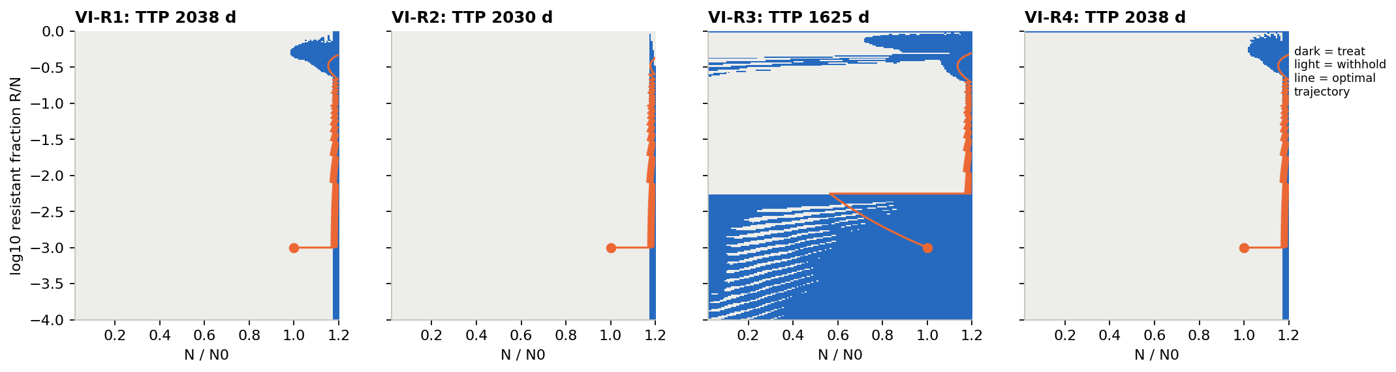
The best possible plan is containment
CHAPTER 1 · A BASELINE WE CAN TRUST
Across: tumour size (1.2 = failure line). Up: share of resistant cells. Dark = treat, light = wait, orange = the tumour’s path.
Survival, less drug, lasting control: let the tumour regrow, and treat only when next week would cross the line. About 2035 days, 1.8× the best human rule.
Keep the mix (R3): treats early to balance the mix, then contains. It fails about 400 days sooner, at 1625 days.
What should adaptive therapy optimise?
8
Notes:
If a computer knows the patient perfectly, what is the best schedule for each goal? For three of the four goals the answer is the same, called containment: let the tumour regrow to just below the failure line, then pulse the drug only when the next week would cross it. Keeping as many sensitive cells as the line allows is what slows the resistant ones, which is why it wins for survival, drug use and lasting control at once. R3 is the odd one: it treats early to push the mix toward balance. For reference, the human rules (E1): no treatment 41 days, full dose 452, AT50 673, AT90 932, and a tuned rule (AT-PSC) 1135. If asked: across a map of patients the best plan beats the best AT rule by 2.2 to 6.5×. The grid values match simulated runs within 1%.

Slide 9
Every AI learned, and beat every human rule
CHAPTER 2 · DOES THE GOAL MATTER?
Days until the tumour crosses the failure line · main virtual patient, weekly decisions
Full dose
452
AT50, the trial rule
673
AT90
932
Best human rule (tuned)
1135
AI agent, survival goal
1744
Best possible plan
2038
All 40 AIs trained (10 per goal). They reach 85–87% of the best plan for R1, R2 and R4, and 76% for R3, and pass the best human rule within 150,000 practice steps.
What should adaptive therapy optimise?
9
Notes:
We trained 10 AIs per goal, 40 in total, with identical settings; only the reward differed. Every one trained, and every one beats every human rule: about 50% longer than the best tuned rule, and 2.6× the trial rule AT50. They reach about 85% of the exact best plan. Why they stop short of 100% turns out to matter in chapter 3: it is a safety margin. If asked: values are medians over 10 seeds; R1 1744, R2 1726, R3 1494, R4 1751 days. R3 is hardest to learn because its reward mostly comes from delaying one big penalty far in the future. The tuned human rule (AT-PSC) ends up as “treat whenever the tumour is above its starting size”.

Slide 10
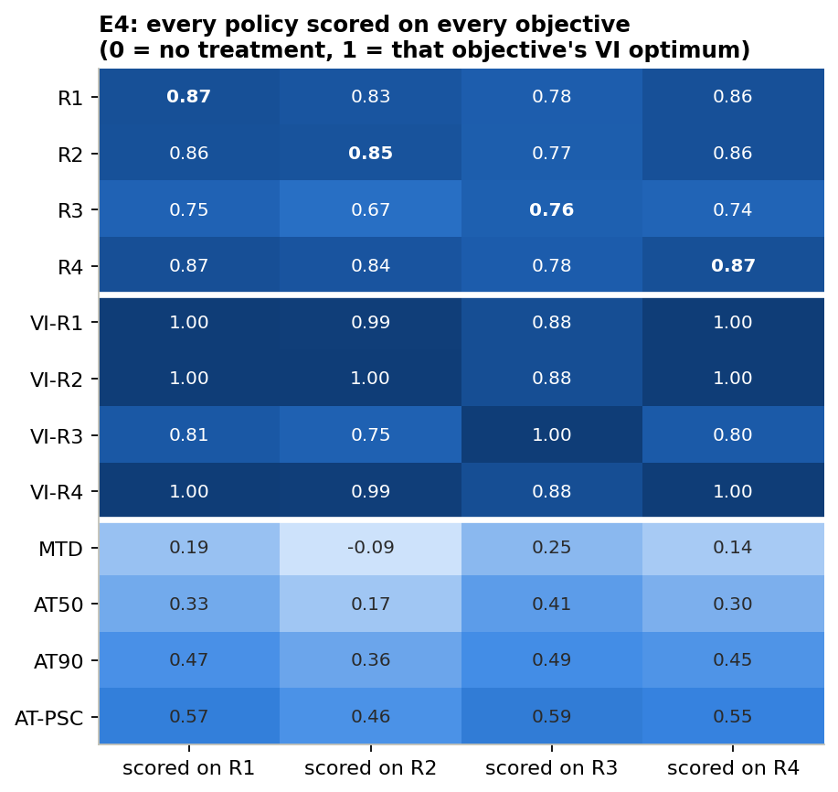
Training on “keep the mix” costs 12–18% on every other goal
CHAPTER 2 · DOES THE GOAL MATTER?
0.12–0.18
lost on each other goal by AIs trained to keep the mix (R3)
≤ 0.02
lost between survival, less drug and lasting control: almost interchangeable
Table: rows = who is scored, columns = the goal used to score them. 1 = best plan, 0 = no treatment.
What should adaptive therapy optimise?
10
Notes:
This is the core experiment (E4). We scored every strategy on every goal, not just the one it was trained for; that is what reveals the cost of choosing the wrong goal. Read across the R3 row: training on keep-the-mix loses 12 to 18 points on every other goal. The other three goals cost each other at most 2 points. The bottom rows are human rules: even the best one scores only 0.46 to 0.59, so every trained AI beats every rule on every goal. If asked: days to failure R1 1744, R2 1726, R3 1494, R4 1751; the difference between goals is clear (Kruskal–Wallis p = 0.00001), and R1, R2 and R4 are not significantly different from each other.

Slide 11
Aiming to survive keeps the mix better than aiming for the mix
CHAPTER 2 · THE SURPRISE
We predicted that AIs trained to keep a balanced mix would outlast survival-trained ones. The reverse held: survival-trained AIs even score higher on the mix goal itself, 0.78 vs 0.76.
What should adaptive therapy optimise?
11
Notes:
This was our headline hypothesis going in, and it failed outright (one-sided test, p = 1). The intuition was that keeping a balanced mix is a smarter long-term route to survival. In this model it is not: aiming directly at survival also gives a better mix than aiming at the mix. The next slide shows what the winning strategy actually does to the tumour.

Slide 12
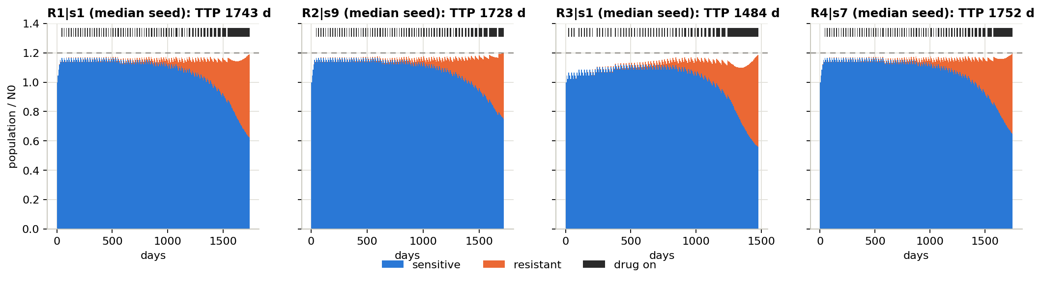
What the winning strategy looks like
CHAPTER 2 · DOES THE GOAL MATTER?
One typical AI per goal. Blue = sensitive cells, orange = resistant, black ticks = weeks on drug, dashed = failure line.
Short weekly pulses keep the tumour just under 1.2× its start. Sensitive cells stay plentiful; the resistant clone grows anyway and finally fills the space.
Survival and lasting control learn the same strategy. Every AI also treats a little early (about 1.15× vs the plan’s 1.17×), a safety margin it found on its own.
What should adaptive therapy optimise?
12
Notes:
All four AIs learn containment with short weekly pulses. Near the end the drug is on almost every week, because the resistant part is big enough that every week threatens failure. The R3 AI treats from day one and fails about 260 days sooner (1484 vs about 1740 days). In E5 we compared the AIs’ decisions directly: 5 of the 6 pairs of goals make measurably different choices, but survival (R1) and lasting control (R4) are no more different than two copies of the same goal. If asked: R1 and R2 disagree on 13% of decisions against a 4.7% luck level; thresholds R1 1.14, R2 1.15, R3 1.08, R4 1.15 of the starting size, against 1.17 for the best plan; the test is a permutation test with 5000 shuffles, corrected for six comparisons.

Slide 13
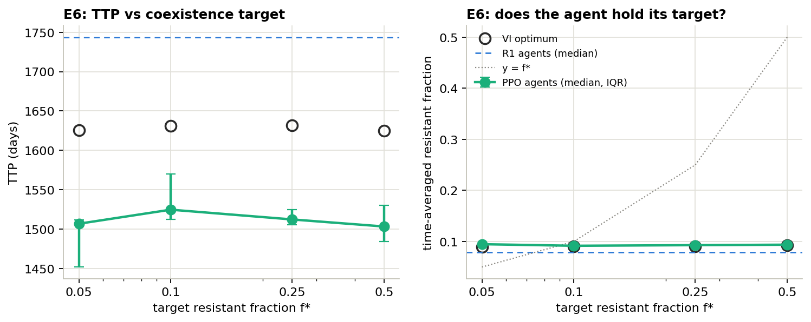
Why “keep the mix” can’t win
CHAPTER 3 · STRESS TESTS
In a tumour that will eventually fail, resistant cells grow under every schedule, so a fixed mix can never be held. We tried three ways to rescue it.
Any target, 5% to 50% (E6)
All land near 1510 days; the real resistant share stays about 9%.
Smoother rewards (B2)
Even worse: best plan 1387 days vs 1625 for the original.
Partly resistant cells (FE2)
Still loses 18–21% wherever the patient can fail.
What should adaptive therapy optimise?
13
Notes:
Why does keep-the-mix lose so consistently? In any patient who will eventually fail, the resistant population grows under every schedule, so a stable two-cell mix simply cannot be held, and the reward collapses into “treat early, then contain”. We tried three ways to rescue it. The figure is E6: left, days to failure for each target (green = AIs, circles = best plan, blue dashed = survival-trained AIs); right, the resistant share actually reached, flat near 9% whatever the target. Smoother rewards (B2) were worse, and letting the drug partly affect resistant cells (FE2) helped every goal but R3 still lost about 20%. If asked: a target is held exactly only in patients who never fail (E6b), where the goal no longer matters. FE2 also corrected our plan: the drug only shrinks partly sensitive resistant cells if cells also die naturally.

Slide 14
The answer held in every stress test we ran
CHAPTER 3 · STRESS TESTS
Stress test | What happened to “keep the mix” (R3)
20 virtual patients the AI had never seen (E7) | last on 20 of 20
Model numbers off by up to ±25% (E8) | still last
Two other ways the drug could act (E10) | still last
Resistant cells grow 42% slower (E3c) | costs 13–17% on other goals
Cells also die naturally (A1) | costs up to 17% on other goals
A map of 25 different patients (C1) | 20–23% shorter survival
Failure line at 1.1×, 1.2× or 1.3× (B4) | 14%, 20%, 27% shorter
Also robust: survival = lasting control. R1 and R4 pick the same plan at all 25 map patients. The only splits are tiny (a half-dose detail, D1; mutation, FE1).
What should adaptive therapy optimise?
14
Notes:
We then threw every stress test we could at the result; each line is one experiment. New patients, wrong model numbers, different drug mechanisms, slower resistant cells, natural cell death, a 25-patient map, a different failure line: keep-the-mix came last every time. Survival and lasting control also stayed the same strategy throughout. The two splits are small: with a half dose, R1 differs only because its drug-free bonus pays at zero dose alone (fix the bonus and they match again); with ongoing mutation the best plans differ slightly, but trained AIs cannot detect it (p = 0.18). What we do not claim: the order among R1, R2 and R4, which changes from patient to patient. If asked: E7 new patients R1 2651, R2 2804, R3 2075, R4 2782 days; in E10 the AIs were never retrained on the new drug, and with a log-kill drug they barely changed (1732 vs 1744 days) while AT50 fell to 828; C1 is best plans only.

Slide 15
Two practical lessons from the stress tests
CHAPTER 3 · STRESS TESTS
A safety margin beats a perfect plan
Check as often as the AI was trained
Model numbers off by up to ±25% (E8)
Check-up rhythm (E9)
1680–1730 d
83 d
AI agents (survival, less drug, lasting control)
weekly-trained AI checked only monthly: worse than any human rule
110–160 d
89–100%
the exact best plan, in its worst quarter of patients
The exact plan rides right on the failure line; the AIs’ habit of treating early protects them.
of the monthly best plan, for monthly-trained AIs at every rhythm
Never use a strategy with fewer check-ups than it was designed for.
What should adaptive therapy optimise?
15
Notes:
Two results from the stress tests matter for any clinic. Left (E8): real patients never match the model exactly. When we changed each model number randomly by up to 25%, the AIs barely noticed, but the exact best plan failed within a few months in about a quarter of patients, because it keeps the tumour right at the failure line. The AIs’ learned margin costs about 15% in the perfect model but buys reliability. Right (E9): AIs trained with weekly check-ups and then checked only monthly failed by day 83, worse than any human rule. AIs trained monthly work at every rhythm. This replicates what Gallagher et al. reported. If asked: R3-trained AIs stayed last at every error level (1450–1500 days); fewer check-ups also lower the ceiling (best plan 2038 days weekly, 1400 monthly).

Slide 16
So far, the AI saw the exact cell mix. A doctor sees only tumour size.
CHAPTER 4 · WHAT THE AI IS ALLOWED TO SEE
In prostate cancer, PSA tracks total tumour size, not how many cells are resistant. What happens when the AI sees only what a doctor sees?
What should adaptive therapy optimise?
16
Notes:
Everything so far assumed the AI sees the exact mix of sensitive and resistant cells. No doctor has that. In prostate cancer, the PSA blood test tracks total tumour size but says nothing about how many cells are resistant. So in this chapter we take that information away. It turned into the most important result of the project.

Slide 17
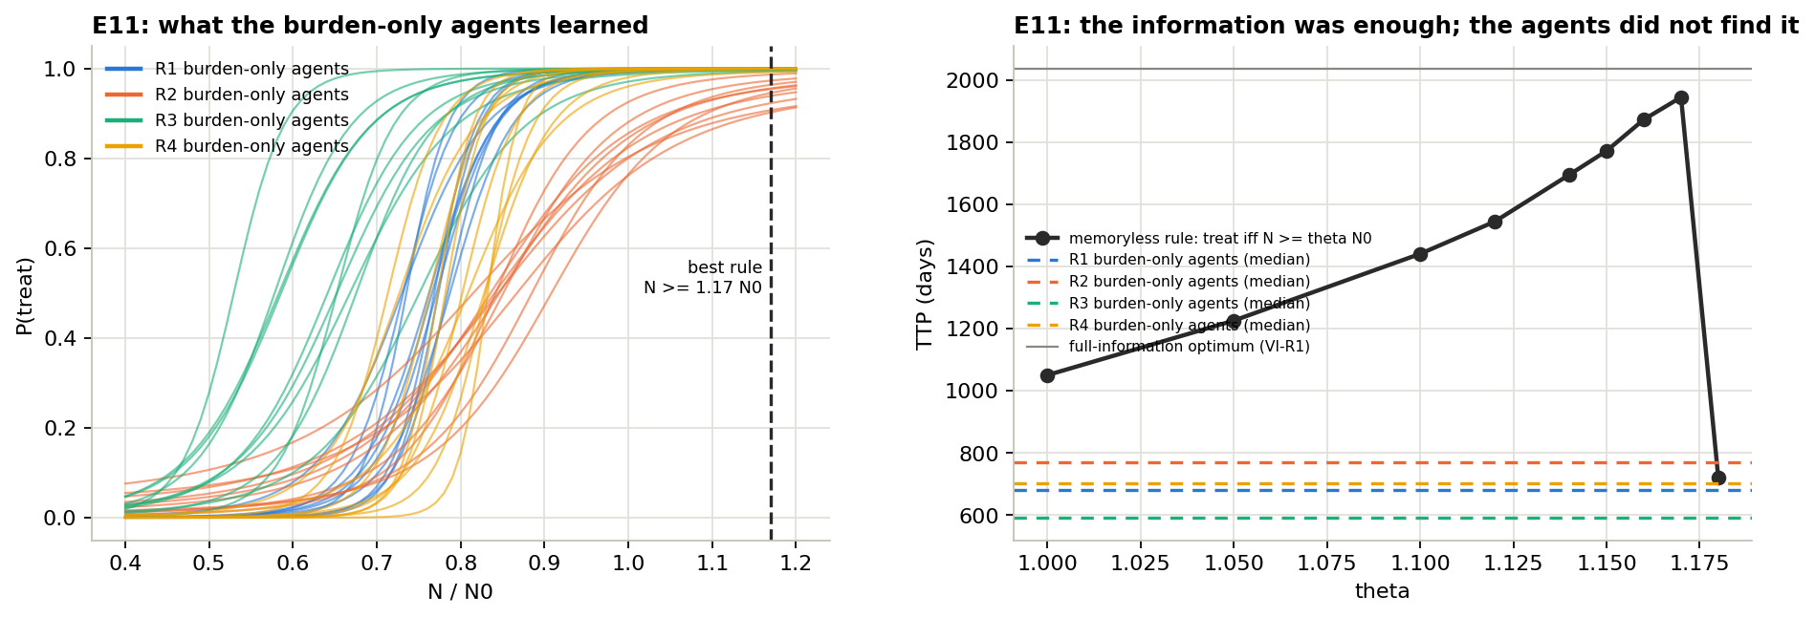
The AIs failed where a one-line rule succeeded
CHAPTER 4 · WHAT THE AI IS ALLOWED TO SEE
AIs that see only size: 0.21–0.37 of the best plan, about 700 days, close to AT50. They treat far too early (left).
The rule “treat if size ≥ 1.17× start”: 1945 days, 96% of the best plan (right). The information was there; the learning failed.
What should adaptive therapy optimise?
17
Notes:
With tumour size alone, the AI failed for every goal: 0.21 to 0.37 of the best plan, about 700 days, close to AT50. The left panel shows why: each line is one AI’s chance of treating at each tumour size, and they start treating at 50 to 90% of the starting size, far too early. The right panel is the key. The black line is a one-line rule, “treat if size is at least θ times the start”, which uses exactly the same information. At θ = 1.17 it reaches 1945 days, 96% of the full-information best plan. So the problem is not missing information; it is learning.

Slide 18
Why it failed, and how we fixed it
CHAPTER 4 · WHAT THE AI IS ALLOWED TO SEE
The problem: a confused judge
The fix: a better judge, in training only
Two tumours, the same size today (1.1× start). Blue = sensitive, orange = resistant.
Decision-maker
sees tumour size only, in training and in use
Tumour A · mostly sensitive · long future
Judge
sees the full cell mix from the simulator, in training only
Tumour B · mostly resistant · fails soon
The AI’s internal judge sees one number for both, so it averages their futures and gives misleading advice.
After training the judge is dropped. The AI you would use still sees only size.
What should adaptive therapy optimise?
18
Notes:
An RL agent has two parts: a decision-maker that picks the dose, and an internal judge that estimates how good a situation is and steers the learning. Seeing only size, the judge cannot tell a mostly-sensitive tumour from a mostly-resistant one of the same size, so it averages over very different futures and its advice is misleading; the decision-maker ends up treating too early. The technical name is critic aliasing. The fix is cheap: in a simulator the full state is always known during training, so we let only the judge see it. The decision-maker, the part you would actually use, still sees only size, as in a clinic. Technical name: an asymmetric actor–critic (actor = decision-maker, critic = judge). Everything else is identical to the failed run: 10 AIs per goal, same training length, same scoring.

Slide 19
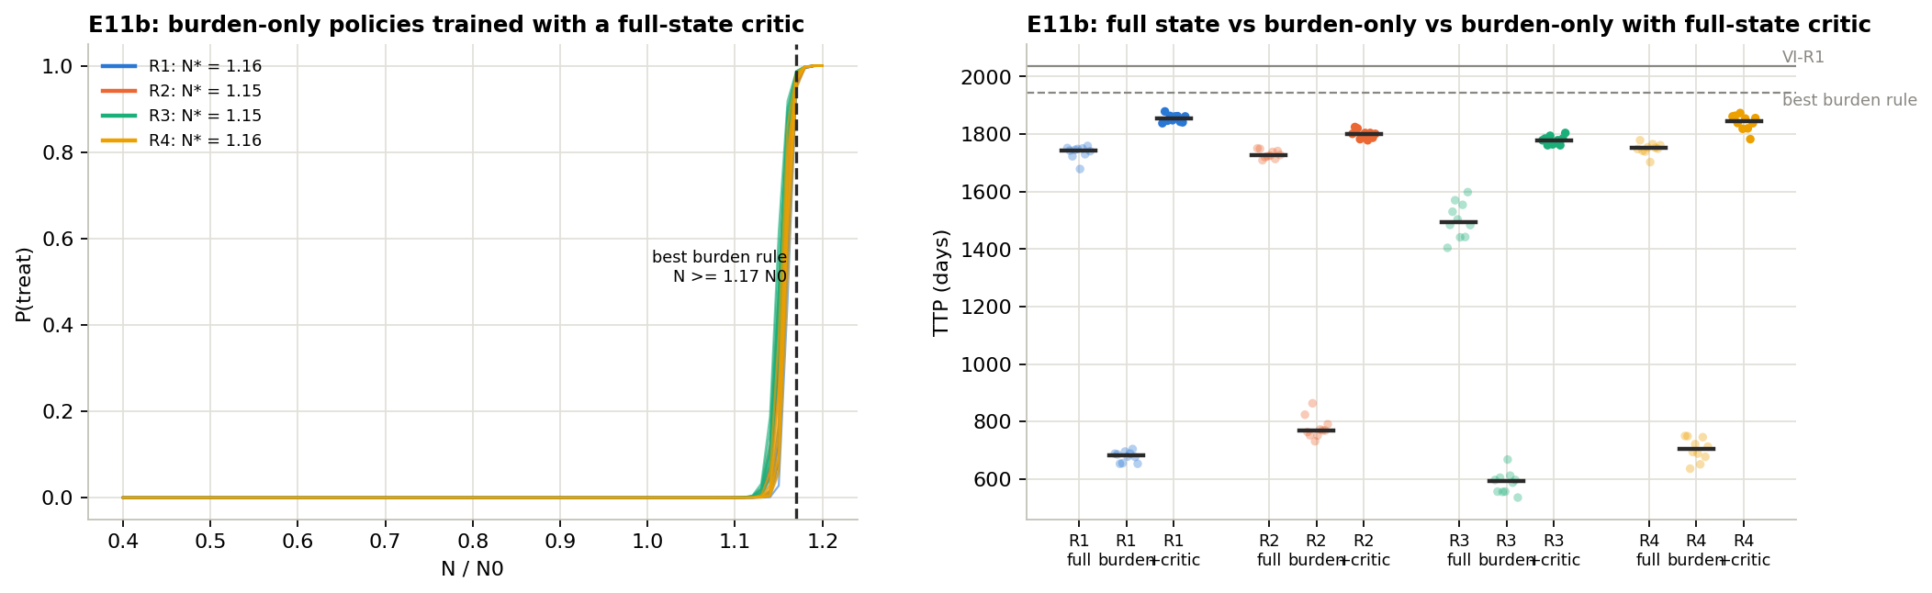
With a better judge, seeing less worked better
CHAPTER 4 · WHAT THE AI IS ALLOWED TO SEE
Left: when each AI treats. Right: days per goal for three AIs: full cell mix · size only · size + better judge (“+critic”).
All 40 trained. Each learned one sharp rule: treat when the tumour passes about 1.15× its start.
1779–1855 days, above the AIs that saw the full cell mix (1494–1751) on every goal.
What should adaptive therapy optimise?
19
Notes:
With the better judge, all 40 size-only AIs train. Each learns one sharp rule: treat when the tumour passes about 1.15 times its starting size, right next to the best size rule at 1.17. And they beat the all-seeing AIs from chapter 2 on every goal: 1779 to 1855 days against 1494 to 1751. Seeing less made the AI better. How to read the right panel: each goal has three columns; the middle one is the failed size-only AI, the right one is this fix, higher than the left one, the full-information AI. Grey lines: full-information best plan 2038 days, best size rule 1945. If asked why seeing less helps: one input is much easier to learn from than the full composition, and the decision-maker learns a single threshold; the next slides check it was not just a training-budget artefact.

Slide 20
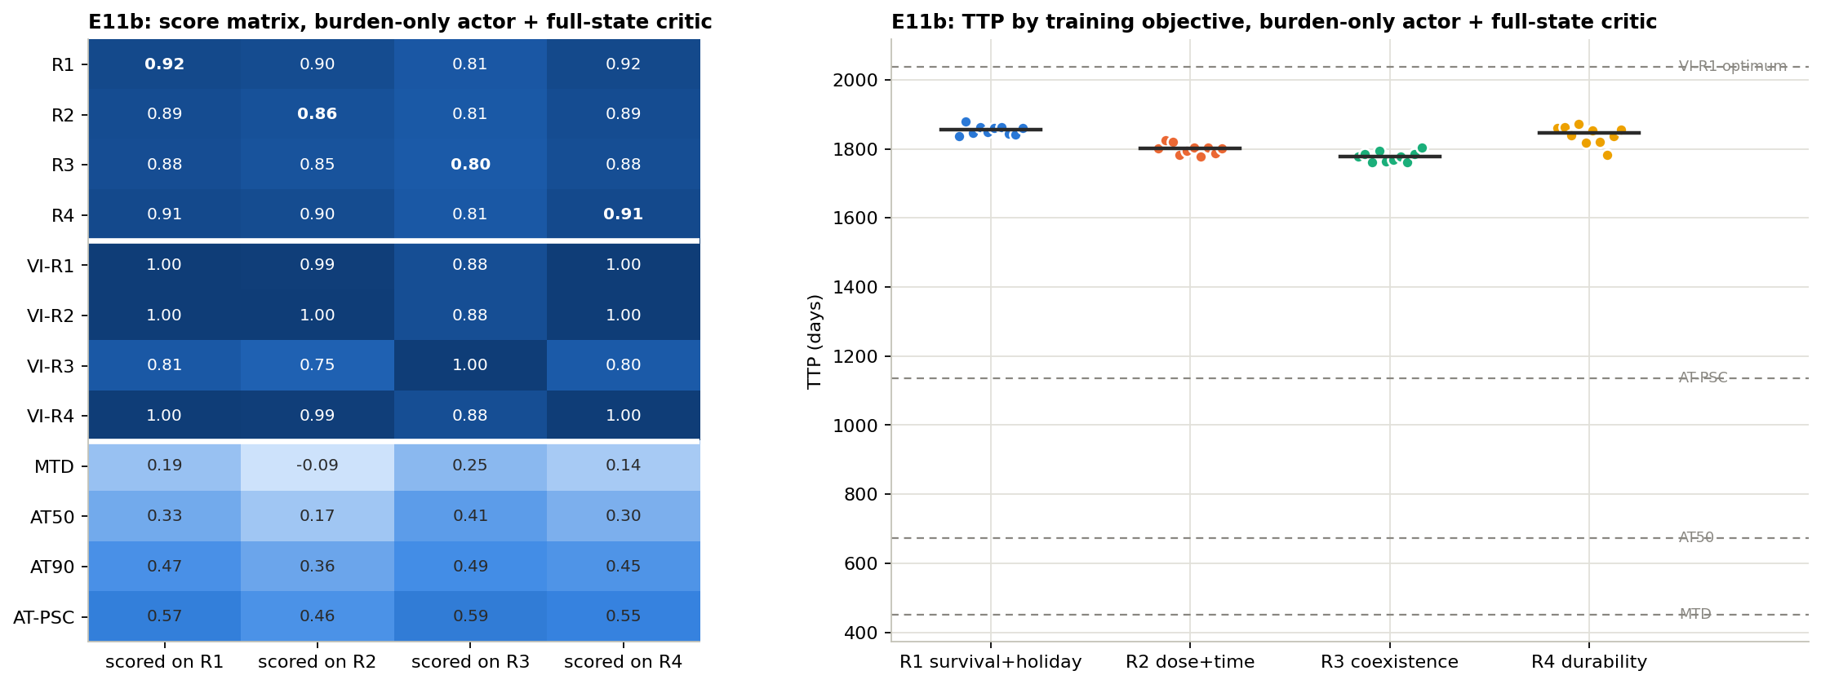
And the four goals nearly merged
CHAPTER 4 · WHAT THE AI IS ALLOWED TO SEE
250 → 76 d
gap between survival and keep-the-mix AIs
18% → 3.5%
worst cost of picking the wrong goal
0.80–0.92
every AI’s score, on every goal
Why: keep-the-mix can’t chase a cell mix it cannot see. Most of the goal effect in chapter 2 needed information a doctor does not have.
What should adaptive therapy optimise?
20
Notes:
And the goals nearly merge. Compare this score table with the one from chapter 2: the R3 row used to score 0.67 to 0.76 on other goals, now every AI row scores 0.80 to 0.92 everywhere, and the dots on the right are tight. The gap between survival-trained and keep-the-mix-trained AIs falls from 250 days to 76; the worst cost of picking the wrong goal falls from 18% to 3.5%. The reason is simple: R3 cannot chase a cell mix it cannot see. This changes how to read chapter 2: much of the difference between goals depended on information a clinician does not have. If asked: 5 of 6 goal pairs still differ statistically and R1 vs R4 still does not; AIs of different goals now disagree on 4 to 14% of decisions, against 13 to 33% with full information.

Slide 21
What the AI sees decides how much its goal matters
CHAPTER 4 · WHAT THE AI IS ALLOWED TO SEE
The AI sees | Score vs best plan | Survival vs mix gap | Wrong-goal cost
The full cell mix (E4) | 0.76–0.87 | 250 d | 18%
Size only (E11) | 0.21–0.37 | did not train | —
Size + better judge (E11b) | 0.80–0.92 | 76 d | 3.5%
Last 8 weeks of size (E11c) | 0.71–0.86 | 220 d | 10.5%
8 weeks, 3× training (E11d) | 0.80–0.92 | 235 d | 13%
A memory brings some differences back, but as noise, not insight. Memory AIs trained on less drug or keep the mix are no better at their own goals than survival-trained ones, and copies disagree 4× more, even with 3× training.
What should adaptive therapy optimise?
21
Notes:
This table puts every way of seeing side by side. Score is each AI on its own goal as a fraction of the best plan; the gap is the difference in days between survival-trained and keep-the-mix-trained AIs; wrong-goal cost is the largest loss from scoring an AI on a goal it was not trained for. We also gave the AI a memory: the last 8 weekly sizes and doses, like a patient chart (E11c), and then 3× more training (E11d). Memory brings back some differences between goals, but not because the AIs serve their goals better: R2- and R3-trained memory AIs score no higher on their own goals than R1-trained AIs, and copies of the same goal disagree about 4× more, unchanged by extra training. If asked: B1 later showed that R2’s memory AIs make a real trade-off, about 285 fewer days for 4 points less time on drug, and sit on the drug-versus-survival frontier; whether that is worth it is a clinical choice.

Slide 22
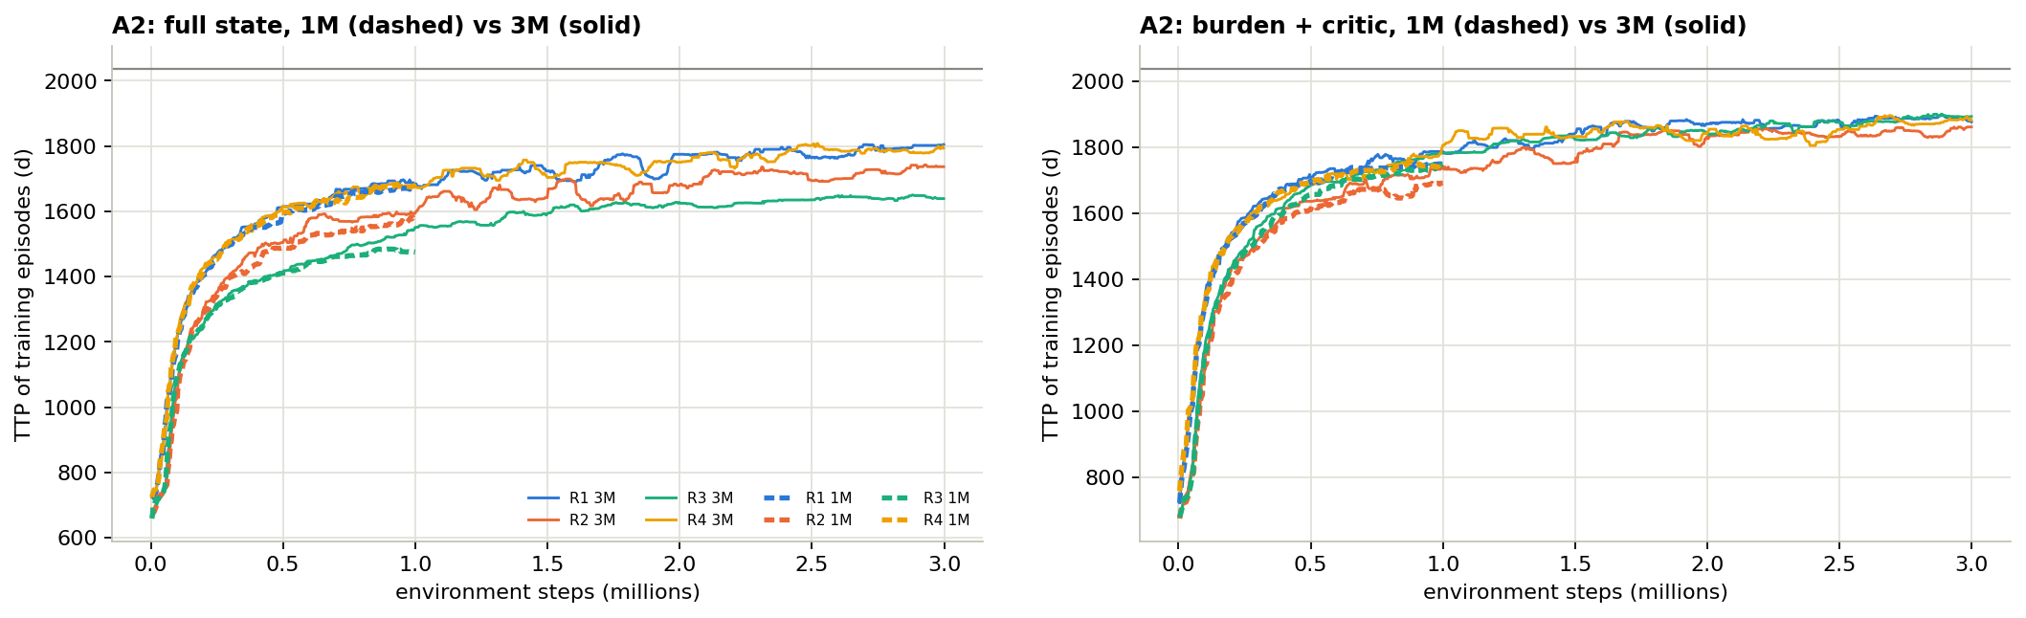
In a fair race, the better judge still wins
CHAPTER 4 · WHAT THE AI IS ALLOWED TO SEE
Survival during training, every AI given 3 million steps (A2). Left: sees the full cell mix. Right: sees size, with the better judge.
0.97
0.94
0.92
1927–1974 d
size + better judge
full cell mix
8-week memory
the best AIs of the whole project
What should adaptive therapy optimise?
22
Notes:
One worry remained: only the memory AIs had 3× training, so was the comparison fair? A2 retrained everything with 3 million steps. Left: AIs that see the full cell mix keep improving, but the goals stay spread apart and keep-the-mix stays lowest. Right: size plus the better judge, all four goals run on top of each other and finish higher. At equal training the order is clear: size plus judge 0.97 of the best plan, full information 0.94, memory 0.92 (scored on the survival goal). These are the best AIs in the project, up to 1974 days against 2038 for the all-seeing best plan, and the worst wrong-goal cost is 2.3%. This turned chapter 4 from suggestive into our strongest finding. If asked: every goal beats its full-information counterpart at equal training (Mann–Whitney p = 0.0002 to 0.0004); with full information and more training, R1 and R3 actually drift further apart (3.8 → 6.1× the luck level).

Slide 23
Towards the reality that would happen in a clinic
CHAPTER 5 · TOWARD THE CLINIC
One smart middle dose
Calmer schedules cost little
Dose levels (D1–D3)
Dose switching (B3, D4)
⅔ dose
9 switches a year
The dose that exactly freezes sensitive-cell growth. A middle dose adds 70–168 days. More dose levels help the exact planner, but make the AI worse.
Best plans change dose on about half of all weeks. Calmed to 9 a year, the plan keeps 87% of its benefit and still lasts 55% longer than the best human rule.
Also checked (B1): good strategies are on drug about 72% of the time, so living longer simply costs more total drug.
What should adaptive therapy optimise?
23
Notes:
Two quick checks on whether these schedules could be followed in practice. Doses: allowing a half dose adds 70 to 168 days, but the most useful middle dose is two-thirds, the dose that exactly freezes sensitive-cell growth; more dose levels help the exact planner but make the AI worse (R2 score 0.85 → 0.80 with five levels). Switching: optimal plans change the dose on about half of all weeks, 28 times a year, which is impractical. A small penalty per switch brings that to about 9 a year while keeping 87% of the benefit: 1755 days, still 55% longer than the best human rule. If asked: R1 ignores the half dose because its drug-free bonus only pays at zero dose; paying the bonus in proportion to drug withheld makes R1 equal R4 again. If a half dose is weaker than half the effect (D3), the gain shrinks (56 to 112 days for R4) but never reverses.

Slide 24
Four things we learned
WHAT WE FOUND
1
Most goals lead to containment
2
“Keep the mix” is the costly mistake
Survival, less drug and lasting control all hold the tumour just under the line.
12–23% worse in every patient and every stress test.
3
AI beats every human rule
4
What it sees beats what it aims for
About 50% longer than the best rule, and sturdier than the exact plan thanks to a safety margin.
Seeing only size, with a better judge in training, every goal does better and the goals nearly merge.
What should adaptive therapy optimise?
24
Notes:
Say these four slowly; they are the whole talk. One: survival, drug-saving and lasting-control goals all lead the AI to the same containment strategy, and survival equals lasting control almost everywhere. Two: aiming for a balanced mix is the one costly mistake. Three: trained AIs beat every human rule by about 50% and are more robust than the exact plan because they keep a margin. Four, the main message: what the AI can see matters more than what it is told to aim for. Evidence: point 1 from E2, E5, E3c, A1, C1 and B4; point 2 from E4, E6 to E10, A1, B2, C1 and FE2; point 3 from E1, E3, E4 and E8; point 4 from E11 to E11d and A2.

Slide 25
What this could mean, and what it can’t claim
FOR MEDICINE
Hypotheses worth testing
Limits
Treat-when-needed containment beat AT50 in every simulated patient
A simple size threshold, about 1.15–1.17× start, captures most of the benefit
Check patients at least as often as the strategy was designed for
One middle dose and about 9 switches a year keep most of the gain
Computer simulation only, no patient data
Two well-mixed cell types; no tumour shape or drug levels in the blood
Trained AIs on three patients; 25 more with best plans only
Our own versions of the four goals; one learning method (PPO)
Adaptive therapy itself is still being tested in patients (Mistry 2021). Nothing here is a treatment recommendation.
What should adaptive therapy optimise?
25
Notes:
These are hypotheses that the simulations support, not recommendations. Each would need testing against real patient data, for example the prostate-cancer datasets these models were fitted to, before anyone could consider it clinically. Adaptive therapy itself is still being tested in patients (Mistry 2021). If asked about other caveats: the best plan is computed on a grid (precise to under 0.4%); in the main comparison the AI sees the cell mix, which clinicians cannot, which is exactly why chapter 4 matters; and longer-lived patients were harder to train at a fixed budget, which mainly affected R3.

Slide 26
Containment wins, and what the doctor can see decides how much the AI’s goal matters.
IN ONE SENTENCE
Next: noisy or delayed readings · AIs with a ⅔ dose · AIs that learn calmer schedules · a side-effects goal
Thank you · Questions
Notes:
If asked for one takeaway: survival, drug-saving and lasting-control goals all lead the AI to the same containment strategy; aiming for a balanced mix is the one costly mistake; and once the AI only sees what a doctor sees, the choice of goal hardly matters, provided it is trained with a better judge. Next steps, in order of priority: noisy or delayed tumour readings, because observation turned out to be the strongest lever; training AIs with the ⅔ dose that helped the planner most; letting the AI see last week’s dose so it can learn calmer schedules itself; and a side-effects (toxicity) goal, the likeliest way to make lasting control truly differ from survival (Gevertz 2026 proposed one).

